Slide 1
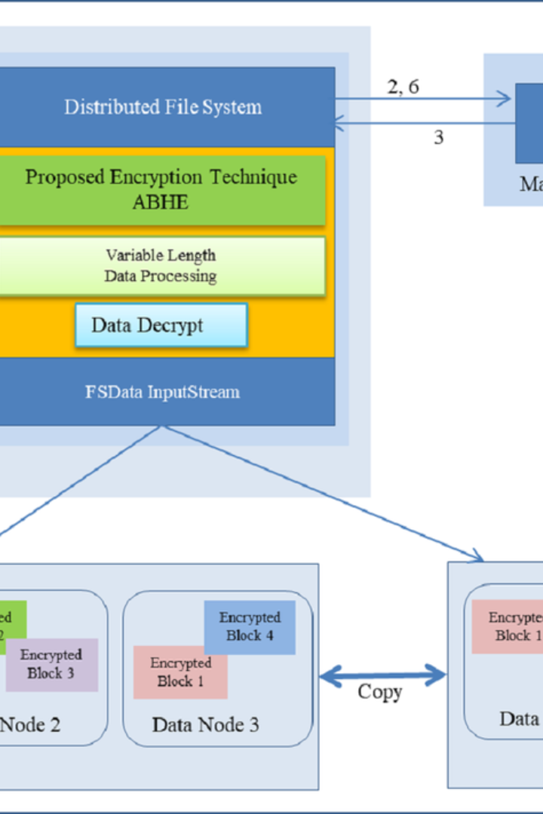

Introduction
Hadoop Distributed File System (HDFS) is a highly scalable and fault-tolerant file system designed for storing large files and streaming data access. It provides high-throughput access to application data and is suitable for applications with large data sets.

Slide 2
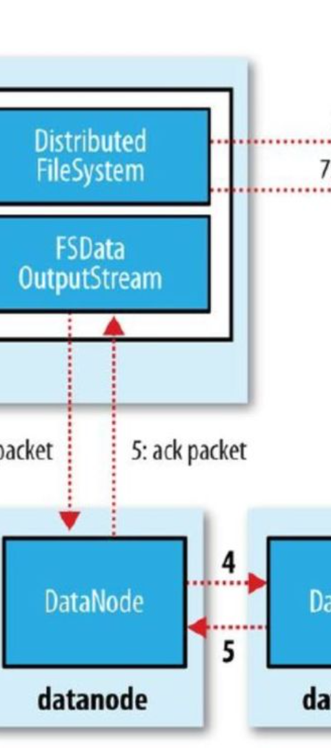
Step 1: Create Directory Structure in HDFS
1
Making Directories
Create directories in HDFS using the 'hadoop fs -mkdir' command to organize and manage your data efficiently.
2
Organizational Advantage
Proper directory structure aids in better data management and facilitates easy access and retrieval.
3
Data Organization
Organizing data in HDFS directories ensures seamless processing and retrieval of specific data subsets.

Slide 3
Step 2: Use the 'hadoop fs -put' command
Transferring Data
Seamless Migration
File Compatibility
Move data from the local file system to HDFS with the 'hadoop fs -put' command.
Effortlessly transition data to HDFS for enhanced storage and processing capabilities.
Compatible with a variety of file formats, the 'hadoop fs -put' command ensures smooth data migration.

Slide 4
Step 3: Use the 'hadoop fs -ls' command
1
File Verification
2
Data Listing
Verify that files have been successfully transferred and are present in HDFS with 'hadoop fs -ls'.
List the files within specified directories to ensure successful file transfer.
3
Status Check
4
Confirmation
Check the status of files in HDFS directories using the 'hadoop fs -ls' command.
Confirm the presence and properties of files in HDFS through the command output.

Slide 5
Step 4: Use the 'hadoop fs -cat' command
1
2
View Contents
Quick Access
Effortlessly view the content of a file in HDFS using the 'hadoop fs -cat' command.
Access file data directly and efficiently through the command line interface.

Slide 6



Step 5: Use the 'hadoop fs -get' command
Data Copy
Local Storage
Download
Copy files from HDFS to the local file system easily and securely using 'hadoop fs -get'.
Effortlessly transfer files from HDFS to the local file system with a simple command.
Download files directly from HDFS to the local system using 'hadoop fs -get'.

Slide 7
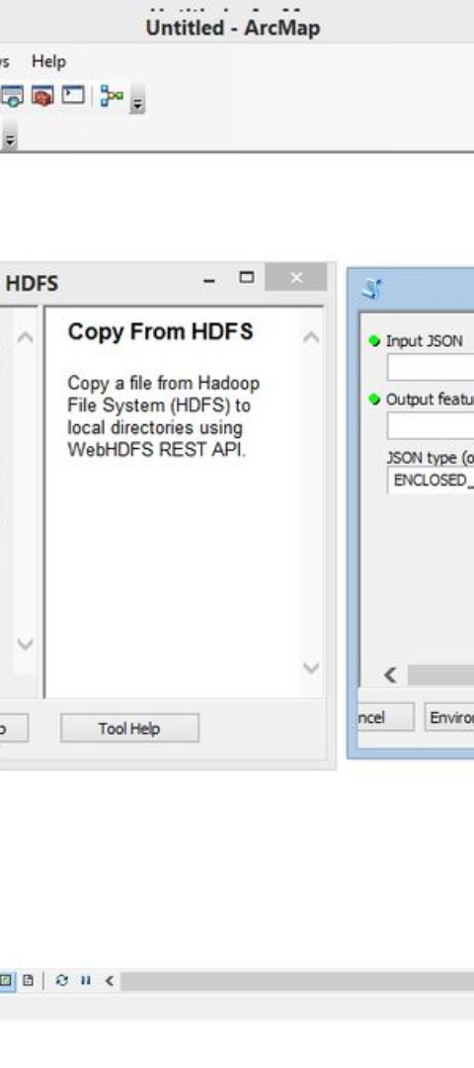



Step 6: Use the 'hadoop fs -rm' command
Select Files
Select and specify the files in HDFS that you want to remove or delete using 'hadoop fs -rm'.
Secure Deletion
Execute secure and controlled file deletion processes directly from the command line.
File Management
Efficiently manage and free up storage space in HDFS by removing unwanted files with 'hadoop fs -rm'.

Slide 8
Conclusion
Efficient Data Handling
Data Security
Streamlined Processes
Securely transfer, manage, and delete files within HDFS to maintain data integrity and security.
HDFS commands facilitate efficient management, transfer, and retrieval of data for scalable computing and analytics.
Streamline data operations with powerful and intuitive HDFS commands for improved productivity and efficiency.

